Slide 1
INTRODUCTION
In October 2010, a revolution took place in the world of high-performance computing.
The Tianhe-1A, constructed by China’s National Supercomputing Center in Tianjin, came from total obscurity to seize the leading position among the world’s best performing supercomputers. With a maximum recorded computing speed of 2,566 TFLOPS (trillion floating-point operations per second), it performs nearly 50 percent faster than the second-place finisher, Cray’s Jaguar supercomputer.

Slide 2
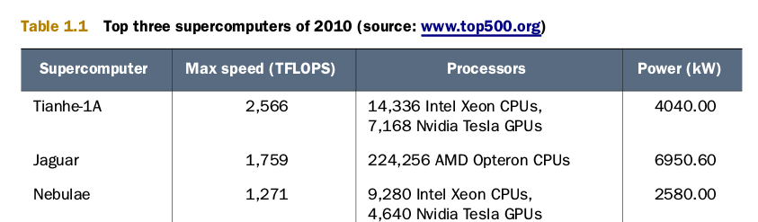
INTRODUCTION
Revolutionary is the presence of GPU s (graphics processing units)

Slide 3
GPU’s
The x86 architecture enjoys a dominant position in the world of personal computing,but there is no prevailing architecture in the fields of graphical and high-performancecomputing.
Despite their common purpose, there is little similarity between Nvidia’s line of Fermi processors, AMD ’s line of Evergreen processors, and IBM ’s Cell Broad-band Engine.
Each of these devices has its own instruction set, and before Open CL , if you wanted to program them, you had to learn three different languages.

Slide 4
Hybrid Computing...
New Era of Hybrid Computing.
Support for Hybrid Computing.
New Support for Super Computer to reduce CPU Hardware.

Slide 5
How can you program these new hybrid devices???
The answer is Open CL (Open Computing Language).
Open CL is Non-proprietary—it’s based on a public standard
Open CL routines can be executed on GPU s and CPU s from major manufacturers like AMD , Nvidia, and Intel, and will even run on Sony’s PlayStation 3.

Slide 6
OpenCL Background Details
Open CL referred to as its own separate language, but this isn’t accurate.
Open CL standard defines a set of data types, data structures, and functions that augment C and C++. Developers have created Open CL ports for Java and Python, but the standard only requires that Open CL frameworks provide libraries in C and C++.

Slide 7
Why OpenC???
(Million Dollar Question..)
what can you do with Open CL that you can’t do with regular C and C++?

Slide 8
Advantages...
Open CL ’s chief advantages: Portability, Standardized Vector Processing, and Parallel Programming.

Slide 9
Portability
OpenCL adopts Philosohpy “Write once, run on anything”.
Every vendor that provides Open CL -compliant hardware also provides the tools that compile Open CL code to run on the hardware.
Write your Open CL routines once and compile them for any compliant device, whether it’s a multicore processor or a graphics card.
You can unify your hardware to perform a common task with a single program.
If you connect more compliant devices, you’ll have to rebuild the program, but you won’t have to rewrite your code.

Slide 10
Standardized Vector Processing
Computational vector--->A data structure that contains multiple elements of the same data type. During a vector operation, each element (called a component) is operated upon in the same clock cycle.
High-performance processors operate on multiple values at once.
Nearly all modern processors are capable of processing vectors, but ANSI C/C++ doesn’t define any basic vector data types.
vector instructions are usually vendor specific. Intel processors use SSE extensions, Nvidia devices require PTX instructions, and IBM devices rely on AltiVec instructions to process vectors. These instruction sets have nothing in common.
with Open CL , you can code your vector routines once and run them on any compliant processor. When you compile your application, Nvidia’s Open CL compiler will produce PTX instructions. An IBM compiler for Open CL will produce AltiVec instructions.

Slide 11
Parallel Programming
Parallel programming assigns computational tasks to multiple processing elements to be performed at the same time.

Slide 12
Keywords..
In Open CL parlance, these tasks are called kernels.
A Kernel is a specially coded function that’s intended to be executed by one or more Open CL -compliant devices.
Kernels are sent to their intended device or devices by Host applications.
Hosts applications manage their connected devices using a container called a Context.
To create a Kernel, the host selects a function from a kernel container called a Program. Then it associates the kernel with argument data and dispatches it to a structure called a Command Queue. The command queue is the mechanism through which the host tells devices what to do, and when a kernel is enqueued, the device will execute the corresponding function.

Slide 13
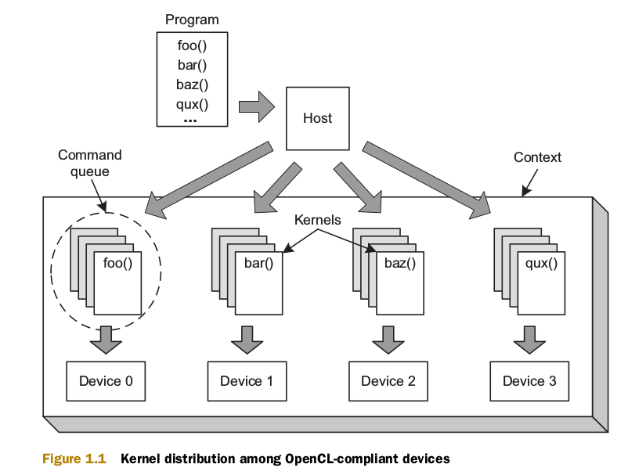
OPENCL System Flow

